Slide 1
Welcome!
Bahar
Orasai
Jeprianto
Lisa
Laura
Robin-Tobias
Ming
Building R packages with Rstudio and GitHub
Eduardo
Emilio
Guillaume
Johannes

Slide 2
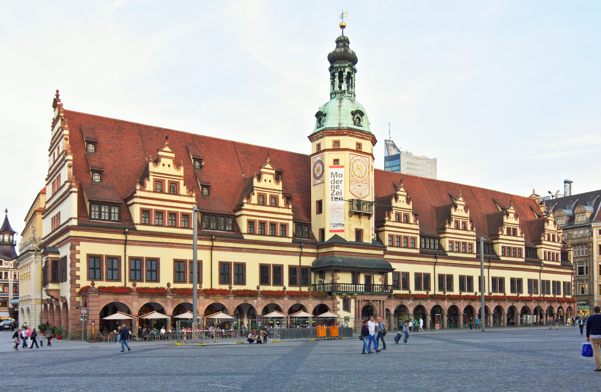
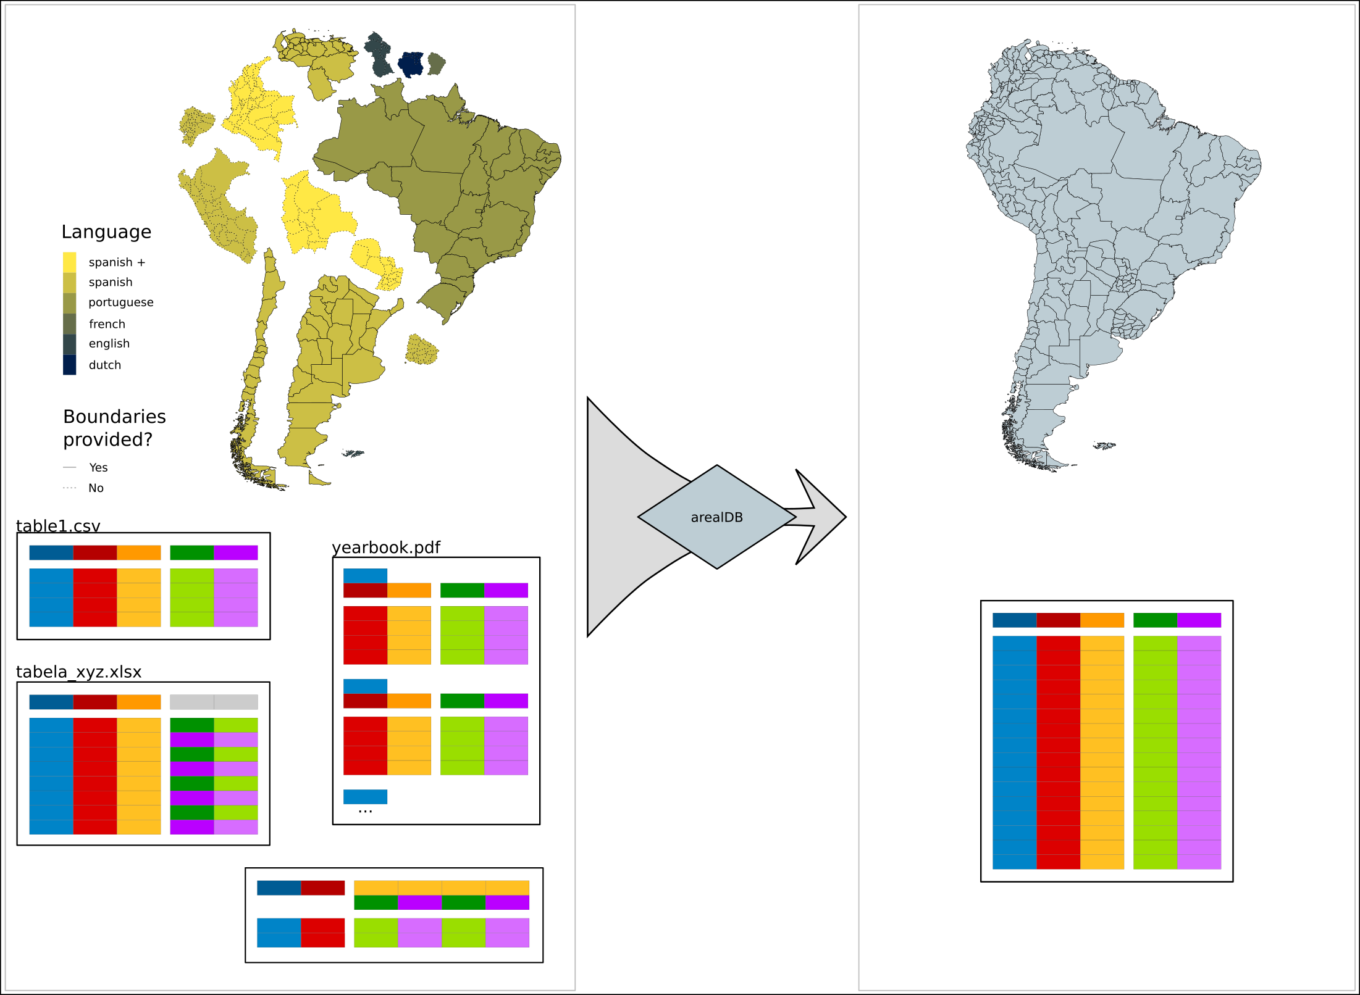


This is us
LUCKINet (luckinet.org)
Alexander Zizka
Steffen Ehrmann

Slide 3
This course
Course time: 9:30 – 18:00
Location: Monday online, Tuesday presence (everybody?)
One Credit point and a course certificate
Today: Theory & Praxis, Tomorrow working on project

Slide 4
Course structure
Course webpage: https://idiv-biodiversity.github.io/yDiv_building_packages_Rstudio_GitHub/
Slack (Everybody?)
Lectures, Demos & Exercises
Course book: Wickham & Brian, https://r-pkgs.org/

Slide 5
Todays schedule
Morning
Hi from Alex and & Steffen
Lectures “Main components of an R-package“
Student project design
“How to build an R package – Tools and workflow“
Afternoon
Demo + exercise 1 “Package skeleton and data”
Demo + exercise 2&3 “Data and Functions”
Demo + exercise 4: “Building and checks”

Slide 6
Course philosophy
Hands on!

Slide 7
A first task

Slide 8

Where are you from?

Slide 9



Where are you based
West
East
Puschstrasse 4, Leipzig

Slide 10
How familiar are you with R?
I installed it
I can
follow
scripts
I can write functions
I am Brian Ripley, leave me alone!

Slide 11
Use of R and Expectations
Break-out rooms, 7 minutes, 2 persons,
Discuss how to finish these sentences, we will collect the results afterwards:
In my research I use R to …
From this course I expect …

Slide 12
Expectations for this course
Better understand the structure of R packages II
Make code more reproducible II
Facilitate sharing code among collaborators

Slide 13
Objective
1. describe the structure of R-packages
2. use up-to-date methodology to provide R code and data as R-package
3. Run with common tools for packaging

Slide 14
Todays schedule
Morning
Hi from Alex and & Steffen
Lectures “Main components of an R-package“
Student project design
“How to build an R package – Tools and workflow“
Afternoon
Demo + exercise 1 “Package skeleton and data”
Demo + exercise 2&3 “Data and Functions”
Demo + exercise 4: “Building and checks”

